Slide 1
4. Robot Force Control
4.1 The 1-DOF Force Control
4.2 The n-DOF Force Control
4.3 Impedance Control
4.4 Constrained Motion Control
- 1 -

Slide 2
4.4 Constrained Motion Control
In the case when the environment is quite rigid and the robot manipulator has to continuously keep its end-effector in contact, a constrained motion approach may be more convenient to describe the system dynamics and to formulate the control problem.
This process of “reducing” positional freedom while developing constraint force leads to the approach where the position/force controllers are designed according to this natural phenomenon.
- 2 -

Slide 3
Constrained Dynamics
Assumption:
The robot is subjected to a holonomic and friction less constraint, that is the constraint satisfy an algebraic equation:
The vector x can be expressed in joint space by the forward kinematics:
Positon constraint function:
Jacobian matrix:
- 3 -

Slide 4
Constrained Dynamics
Position constraints:
Derivative
Kinematic velocity constraints:
The manipulator dynamics is restricted to the manifold defined by S:
- 4 -

Slide 5


Constrained Dynamics
The robot dynamics subjected to constraints：
The interaction torques due to the contact with the environment:
$$τ_{f}=J_{Φ}^{T}(q)λ，τ_{f}∈R^{n}$$
where represents the Lagrange multipliers associated with the constraints.
$λ∈R^{m}$
- 5 -

Slide 6
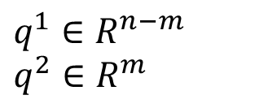
Constrained Dynamics
The presence of m constraints causes the manipulator to lose m degrees of freedom, and leaves (n-m) linearly independent joint variables that are sufficient to the constrained motion.
Without loss of generality, let the vector q be partitioned into
$$q^{1}∈R^{n−m} \\ q^{2}∈R^{m}$$
q¹
are the joint variables describing the constrained motion
q²
are the remaining redundant joint variables
Note that q² should not be taken as the square of q
- 6 -

Slide 7
Constrained Dynamics
The redundant joint variable q² can be completely described by q¹ as
Definition
The dynamics constrained motion become:
- 7 -

Slide 8
Properties
The constrained dynamics have the following fundamental properties:
Define , then is symmetric positive definite and bounded above and below.
Define then is skew symmetric.
3.
- 8 -

Slide 9
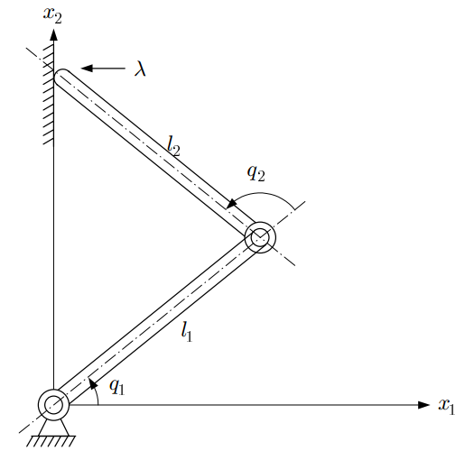
Tutorial Example
In the simulation, the same planar two-link manipulator is considered except it is in constrained motion.
The constraint surface can be written as:
Then non-linear transformation from Cartesian space to joint space:
.
Two-link manipulator with
vertical constraint
- 9 -

Slide 10
Tutorial Example
In terms of joint space co-ordinates, the constraint surface can be expressed as:
Jacobian matrix
Assume
we have
- 10 -

Slide 11
Tutorial Example
With the addition of contact force, the dynamic equations of the robot can be written as
Trajectory Planning
The desired trajectory：
The constraint force：
Simulation Settings
Assuming the parameters vector p
- 11 -

Slide 12
Tutorial Example
The manipulator is initially at rest with
The initial constraint force is assumed to be λ = 0.
The control action use a conventional PD control.
The gains for the controller are chosen as:
Elasticity coefficient of environment：
- 12 -

Slide 13
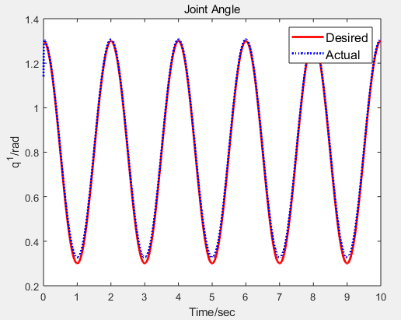
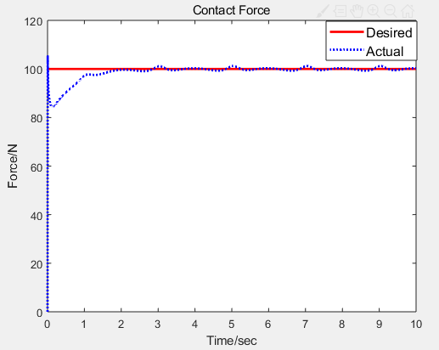
Tutorial Example
Simulation Result
Position tracking of joint q¹
Contact force λ
- 13 -

